Slide 1

Year-End Update

Slide 2
“Partnerships Vision”
Our vision is to encourage and equip less-resourced Majority World pastors through biblical teaching and resources. Beginning in Uganda, we will assist national church leaders, Theological Institutions and mission partners as they nurture pastors and develop emerging leaders to the glory of God.

Slide 3
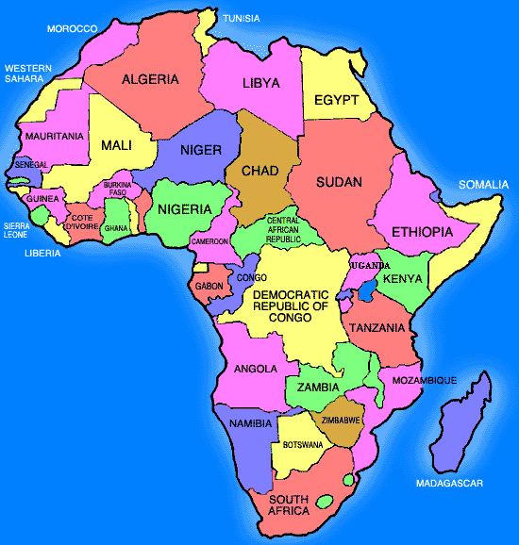
Partnerships in Uganda and Zambia

Slide 4

Partnerships and Focus
Areas in Uganda
Partners
Kampala Baptist Church
Kampala Evangelical School of Theology
WorldVenture Mission
Focus Areas
Kampala
Masaka
Oyam
Central Uganda in 2017

Slide 5
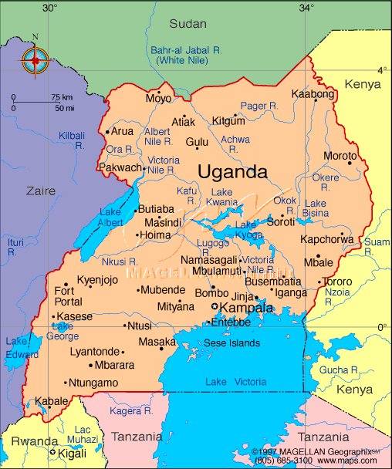

Slide 6
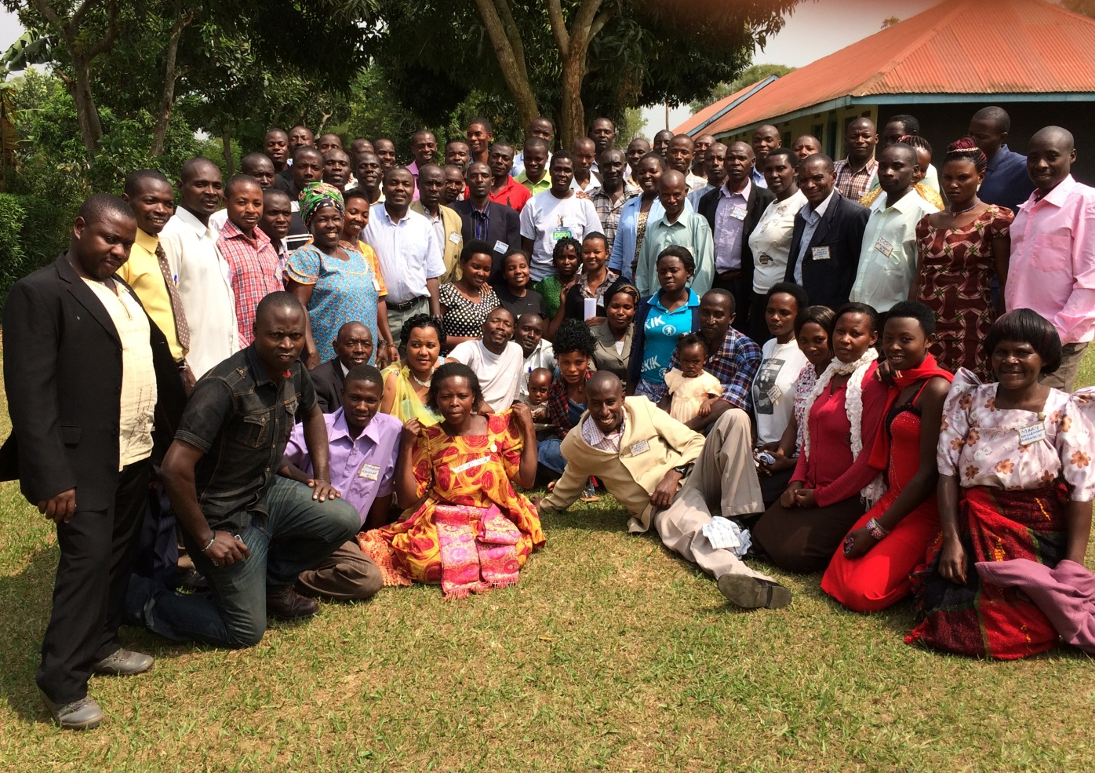
Masaka Large Group
Training -January

Slide 7
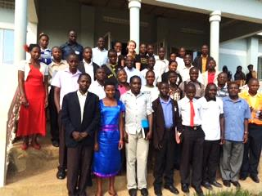
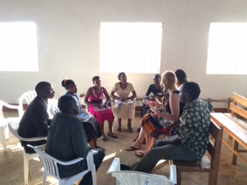
Masaka Training – Emerging Leaders
3 Sessions in 2015-2016 for selected young leaders
Used 2 Timothy and Nehemiah as our texts
Small Group Mentoring around themes

Slide 8
January 16-19, 2017
January 16-18 - Large Group Training for Pastors and Church Leaders for 90 + people
January 18-19 - 30 Emerging Leaders join Large Group Training and spend day with the 13 Pastors of the churches where they serve
Once again, Bethel Grove Global Missions is planning to assist in covering some of the costs for the large group Training.

Slide 9
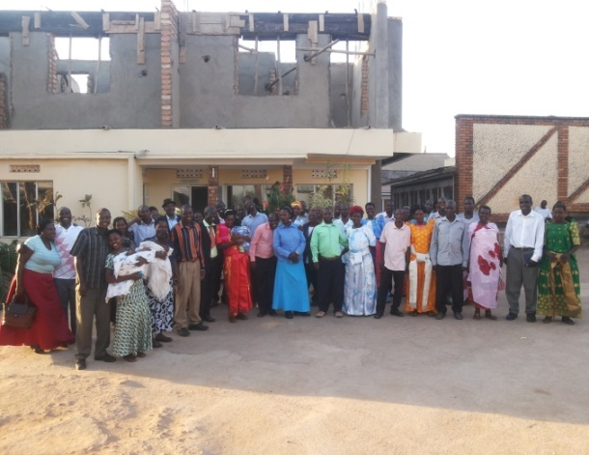
Marriage Conference for Pastors and Wives - September 2016

Slide 10
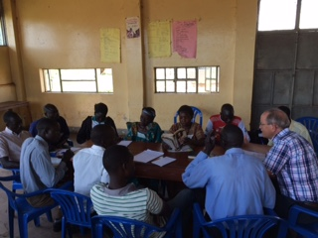
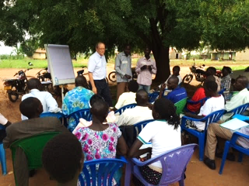
Oyam Training – 2016
April and August

Slide 11
Future Oyam Training
January 12 – 13, 2017 – Final Large Group training in Southern Oyam region with study of Deuteronomy
Since September 2016, KBC offered two training sessions in Northern Oyam funded by “Partnerships”. 2017 goal is to identify those who have gifts of teaching and leadership for training.
Future Oyam training will be by those who can train pastors and church leaders in the Lange language

Slide 12
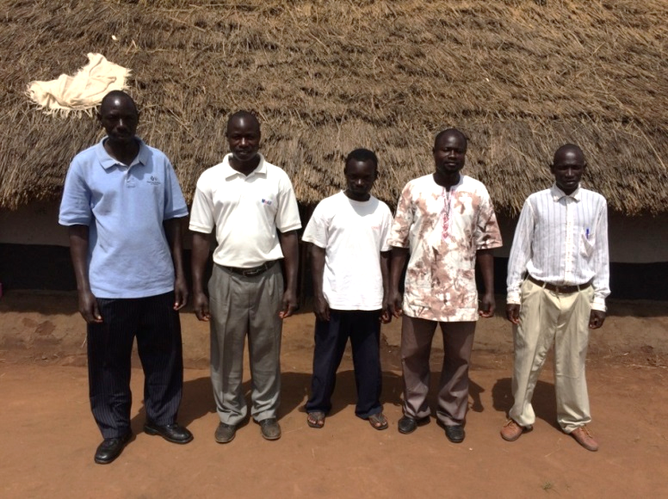
Trainer of Trainers in Uganda:
New Focus for 2017 - 2018
5 Leaders from Masaka, 5 from Oyam and 5 from Central Uganda Churches will be selected for one week-long study sessions in June and November. These Leaders will carry on the training of Pastors in the future throughout Ugandan regions.

Slide 13
Central Region Training in 2017
Central Region includes: Mubende, Mityana, Kiboga, Wakiso, Kampala, Mukono Buikwe, Bugerere, Nakaseke Luwero, the islands on L. Victoria and Mpigi districts.
Partnerships include:
KBC, Partnerships For Training Pastors and WorldVenture

Slide 14
KBC’s New Focus – Central Region
Andrew’s new responsibility for training of churches given by Baptist Union of Uganda
Accomplished through a partnership with WorldVenture , Partnerships For Training Pastors and hopefully KEST.
Using people trained in “Training of Trainers” sessions to work in Central Uganda

Slide 15
Ugandan Focus in 2017
Oyam and Masaka Training Sessions Jan. 9–23
Jamima’s Wedding – April 22
June Training of Trainers and Central Region Training Sessions
Possible Course at KEST – November
November Training of Trainers and Central Region Training Sessions

Slide 16
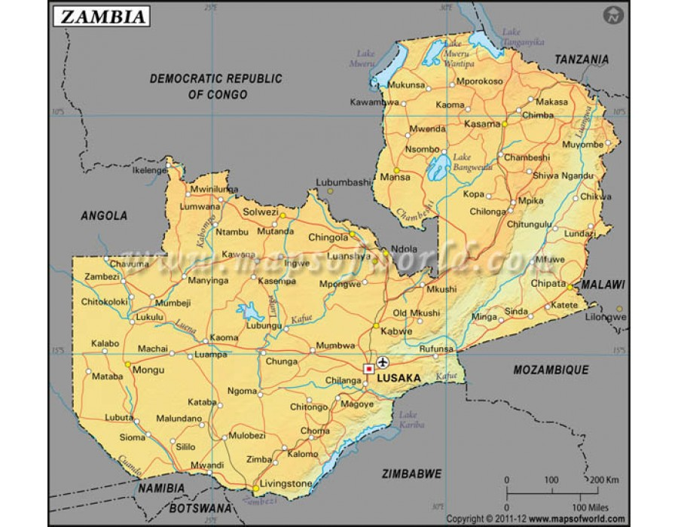

Slide 17
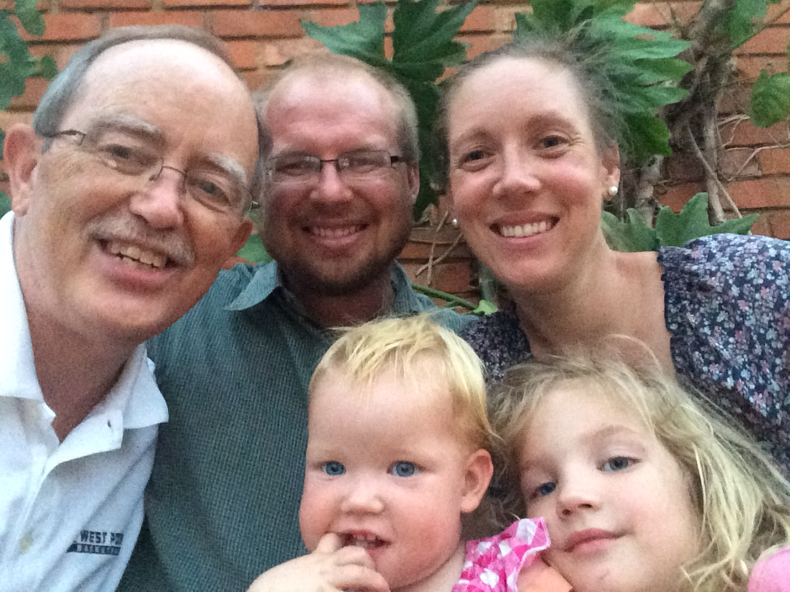
Partnering With the Colvins

Slide 18
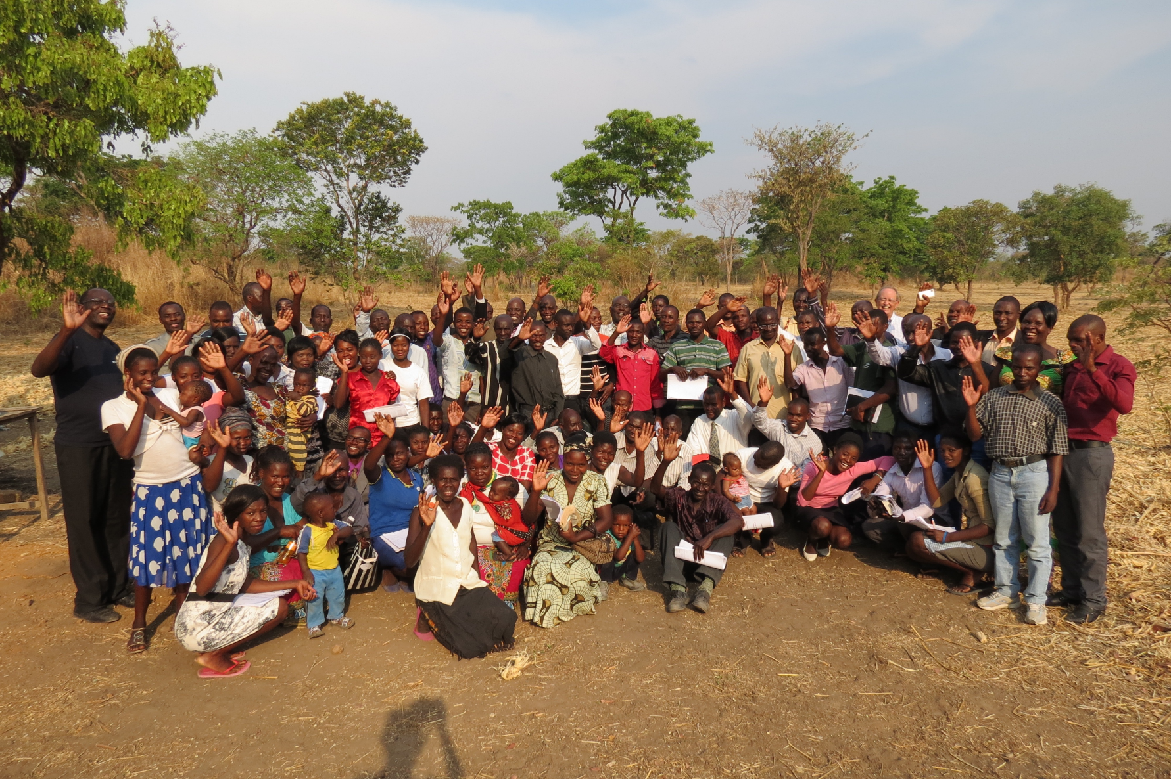
Zambia – Choshen Farm

Slide 19
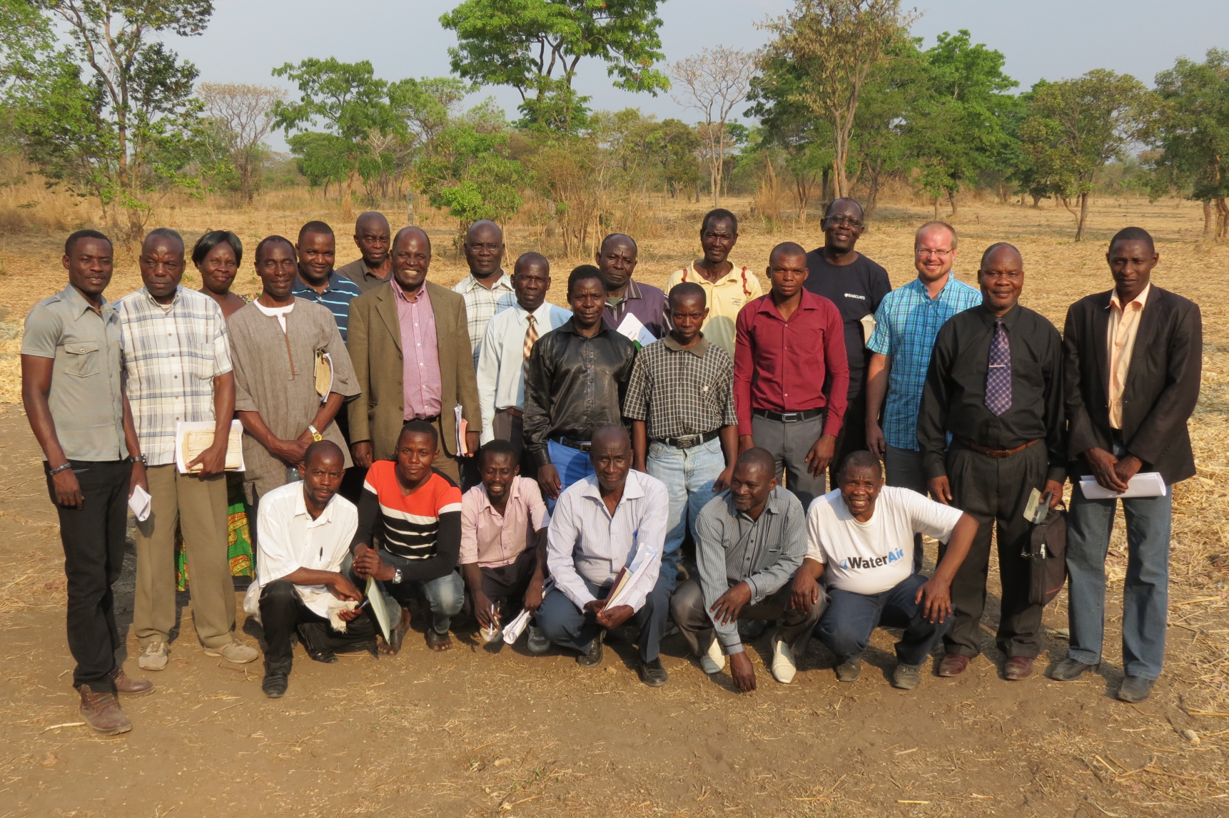
Zambia – Choshen Farm
Mansa Pastors Fellowship

Slide 20
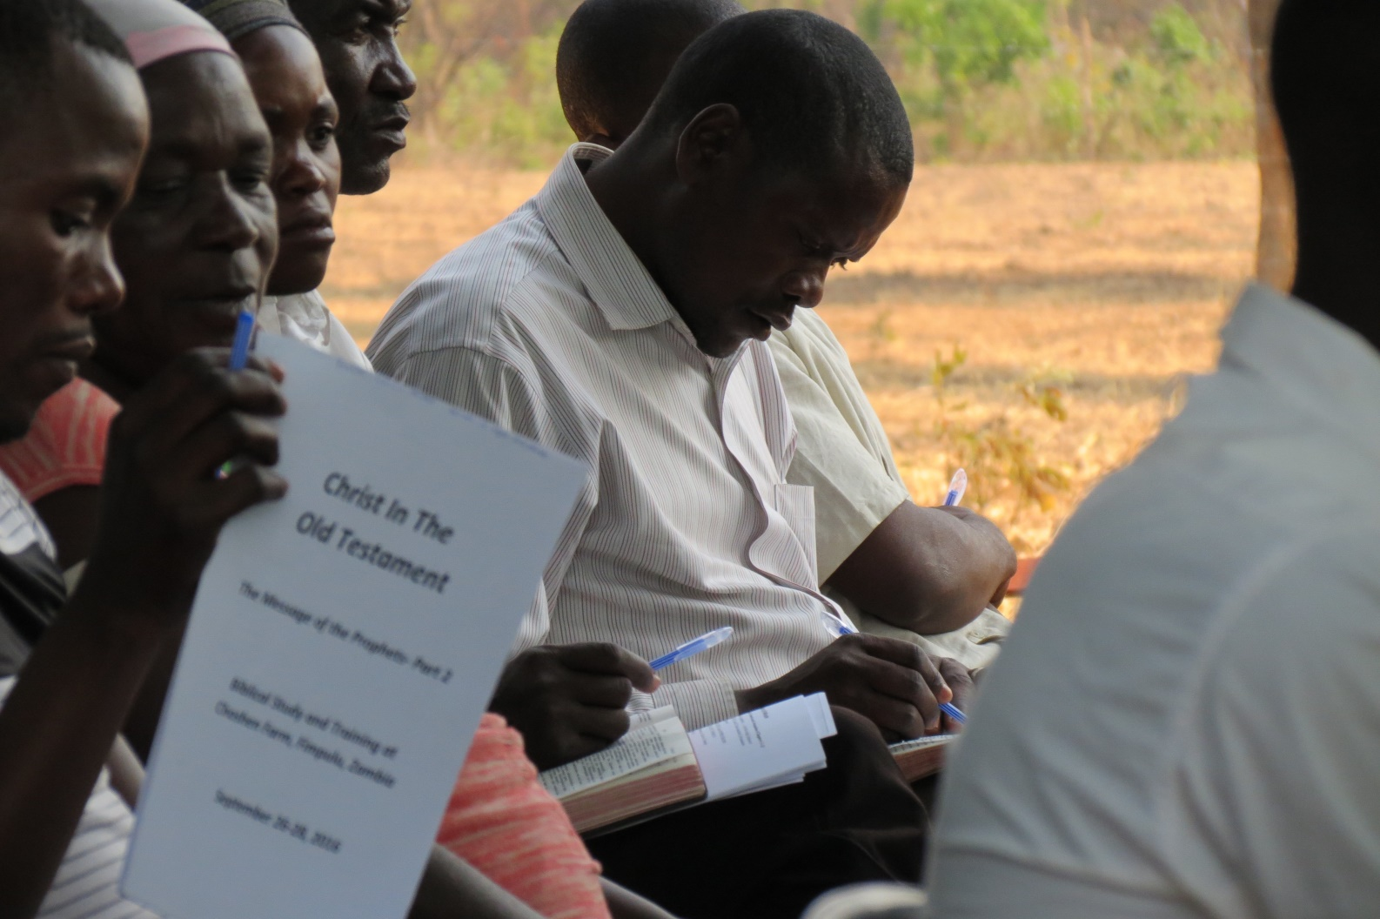
Zambia Emphasis-
Christ in the Old Testament

Slide 21
Zambia Focus in 2017
April 27- 30 Visit Mansa Pastor’s Fellowship and churches with a few other Ithaca Pastors
May 1-3 Fifth and Final Large Group Training of Post-Exilic Prophetic and Historical Books
Attempt to compile into a resource booklet the main emphasis of Christ in the Old Testament either in Bemba or English

Slide 22
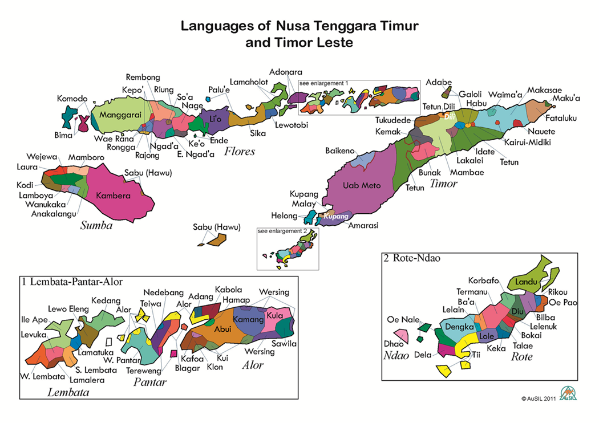
Partnership in Indonesia

Slide 23
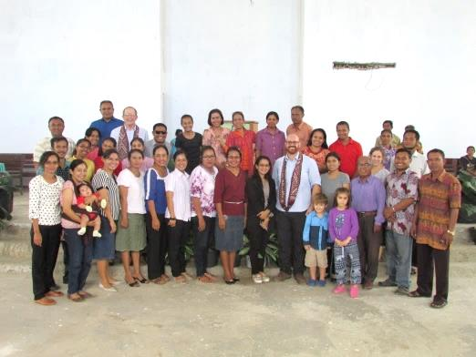
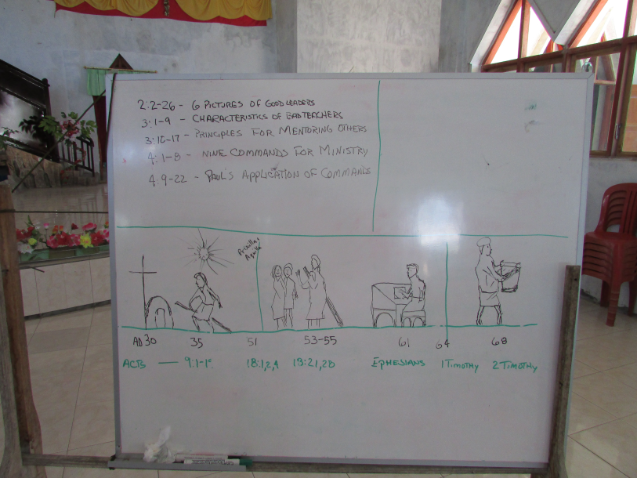
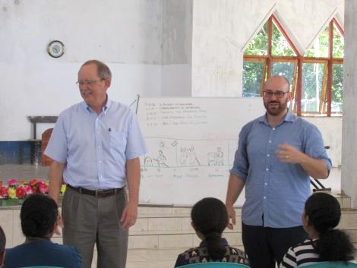
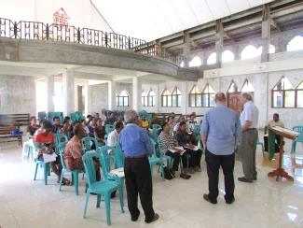
Pastors and Church
Leaders Training

Slide 24
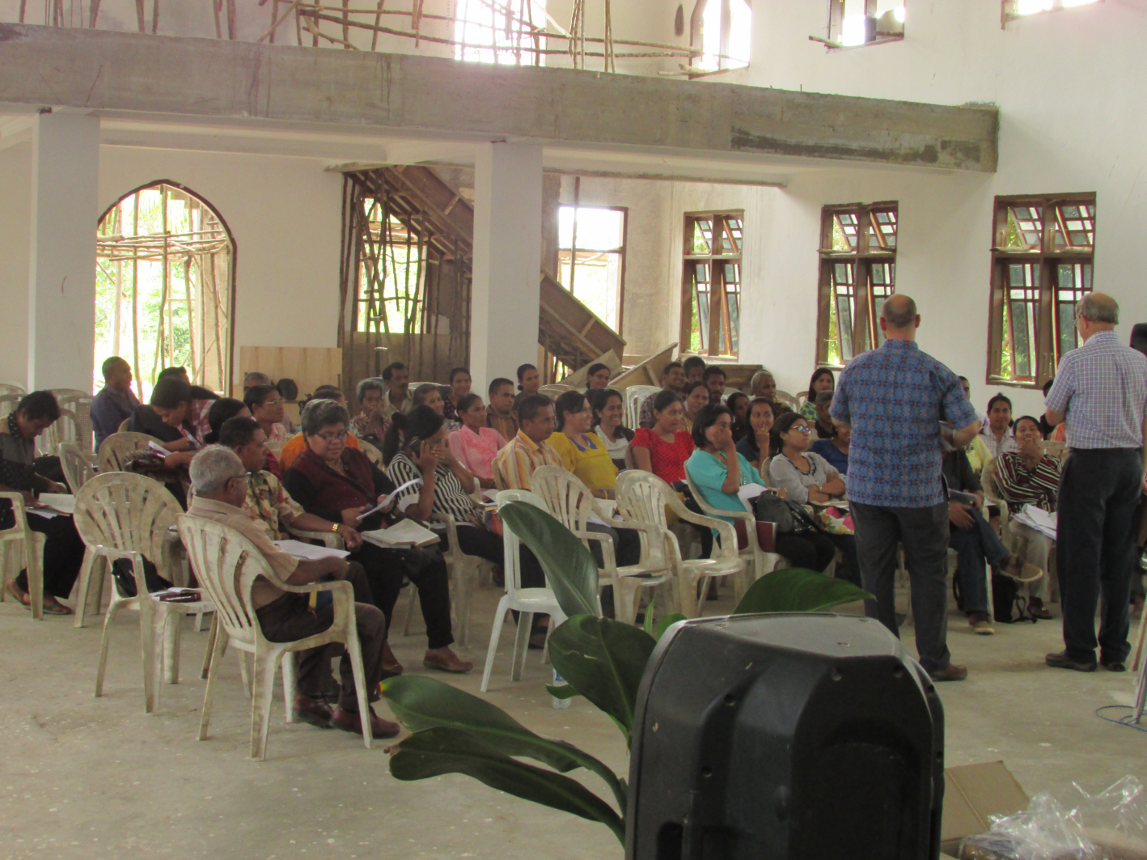
Training in 3 Language Groups

Slide 25
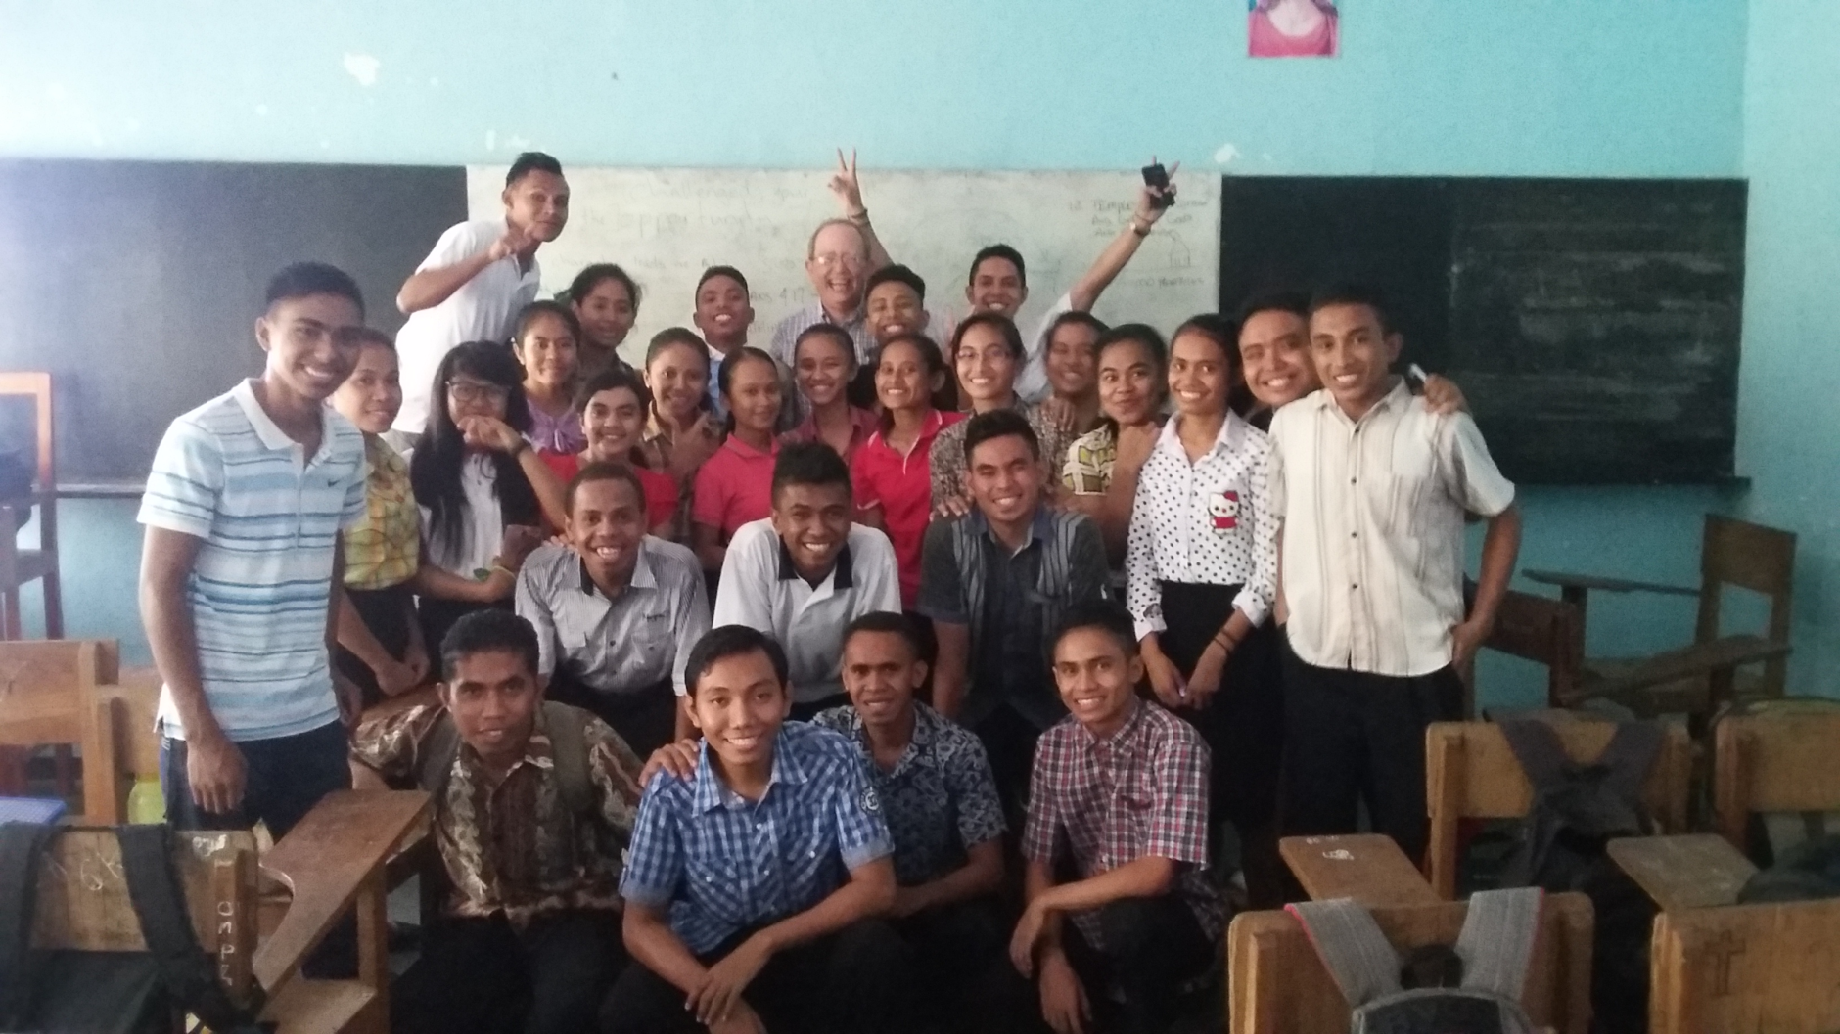
Artha Wacana Christian University

Slide 26
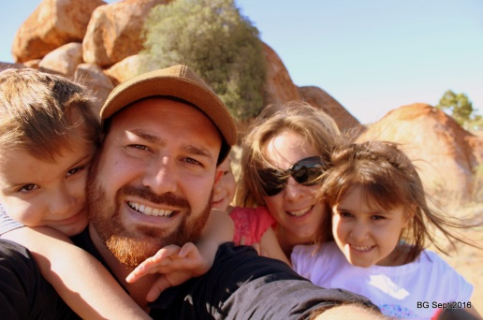
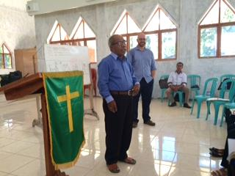
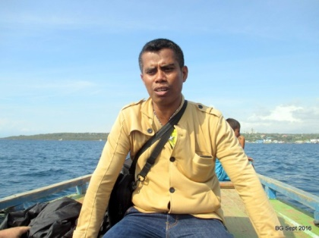
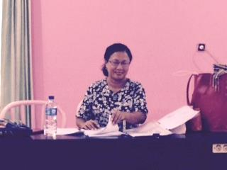
Partners in Timor

Slide 27
Indonesia Focus in 2017
Return in late September to work with Ben Grimes and other partners in training Pastors and Church Leaders
I am invited to teach a 2 week intensive course on “Introduction to the Old Testament” at the Artha Wacana University – October 2-14
Distribute Bibles that are translated into Timorese languages

Slide 28
Resource Development
Discipleship Material in Luganda Language
More music access to songs already produced
Christ in the Old Testament study material
Pastor’s Manual for Special Occasions
2 Timothy Study Guide in various languages

Slide 29
Looking Forward to 2017

Slide 30
Year-End Goals
Identify 40 additional individuals that will receive information and pray for the ministry. Total 425
Identify 7 more people to commit to pray for a
Majority World ministry partner. Total 10
$20,000 goal for special year-end financial support, beyond the monthly and other pledged yearly gifts. To date we have received $4,650

Slide 31
What is the Accountability
Structure for “Partnerships”?
Project under New Horizons Foundation of Colorado Springs. See www.newhorizonsfoundation.org
An Accountability Group meets 2 times/year to hear plans, give advice and provide vision accountability
A Reference Group introduces us to others and provides international credibility
All our partners are accountable to leadership, so we are part of their evaluation process

Slide 32
Please Pray
Give thanks for all that God has done over the years
Pray with us for 2017 ministry outreach
Pray for our Partners and God’s global work
Pray for other possible partnerships and wisdom to know what to do
Pray for Joyce and me as we look forward to several important decisions in the next 2 years

Slide 33
In the Spirit of Philippians 1:3-6
Thanks for your prayers and interest in what God is doing through the Partnerships he has formed. Joyce and I are grateful for your loving support and are thankful for God’s grace to us!

